Slide 1
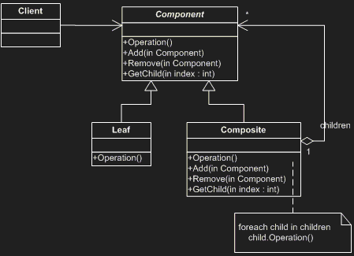

Slide 2
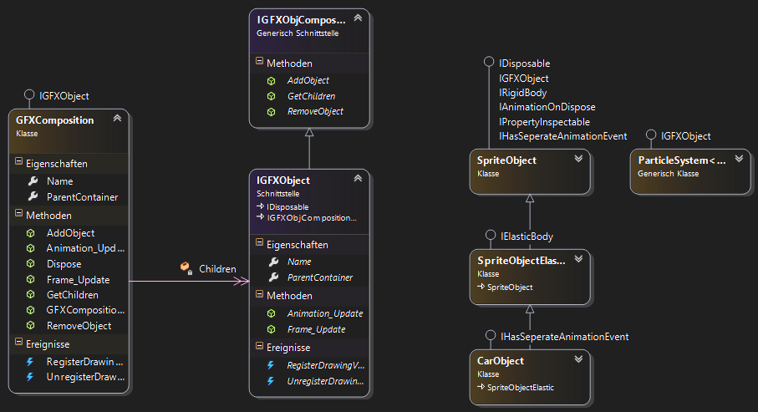

Slide 3
// Objekte erstellen
IGFXObject obj1 = new SpriteObject("Test Sprite");
IGFXObject obj2 = new SpriteObjectElastic("Fussball");
IGFXObject comp2 = new GFXComposition("Blumenbeet");
comp2.AddObject(new SpriteObject("Sehr grüne Pflanze"));
comp2.AddObject(new SpriteObject("Maiglöckchen"));
IGFXObject comp1 = new GFXComposition("Zusammengebautes Object");
comp1.AddObject(new SpriteObject("Teil 1"));
comp1.AddObject(new SpriteObject("Teil 2"));
comp1.AddObject(comp2);
comp1.AddObject(new SpriteObject("Teil 3"));
MainGFX.AddObject(obj1);
MainGFX.AddObject(obj2);
MainGFX.AddObject(comp1);
// Objekt-Baum listen
lstTree.ItemsSource = MainGFX.ToList();

Slide 4
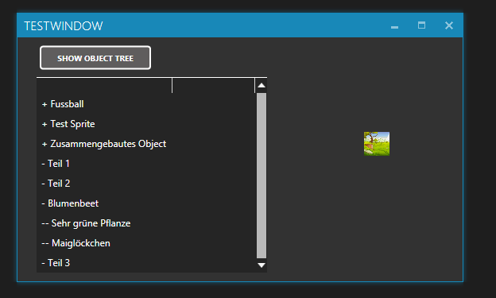

Slide 5
public void Frame_Update(object sender, FrameUpdateEventArgs e)
{
foreach (var item in Children)
{
item.Frame_Update(sender, e);
}
}
public void Animation_Update(object sender, FrameUpdateEventArgs e)
{
foreach (var item in Children)
{
item.Animation_Update(sender, e);
}
}
public void Dispose()
{
foreach (var item in Children)
{
item.Dispose();
}
}
~GFXComposition()
{
this.Dispose();
}

Slide 6
public List<string> GetAllNames(IGFXObject rootObject, int lvl)
{
List<string> lst = new List<string>();
foreach (var item in rootObject.GetChildren())
{
lst.Add((new String('-', lvl)) + " " + item.Name);
lst.AddRange(GetAllNames(item, lvl + 1));
}
return lst;
}
public List<string> ToList()
{
List<string> lst = new List<string>();
foreach (var item in GFXObjects.Values)
{
lst.Add("+ " + item.Name);
lst.AddRange(GetAllNames(item, 1));
}
return lst;
}
public override string ToString()
{
return String.Join("\r\n", this.ToList());
}

